Slide 1
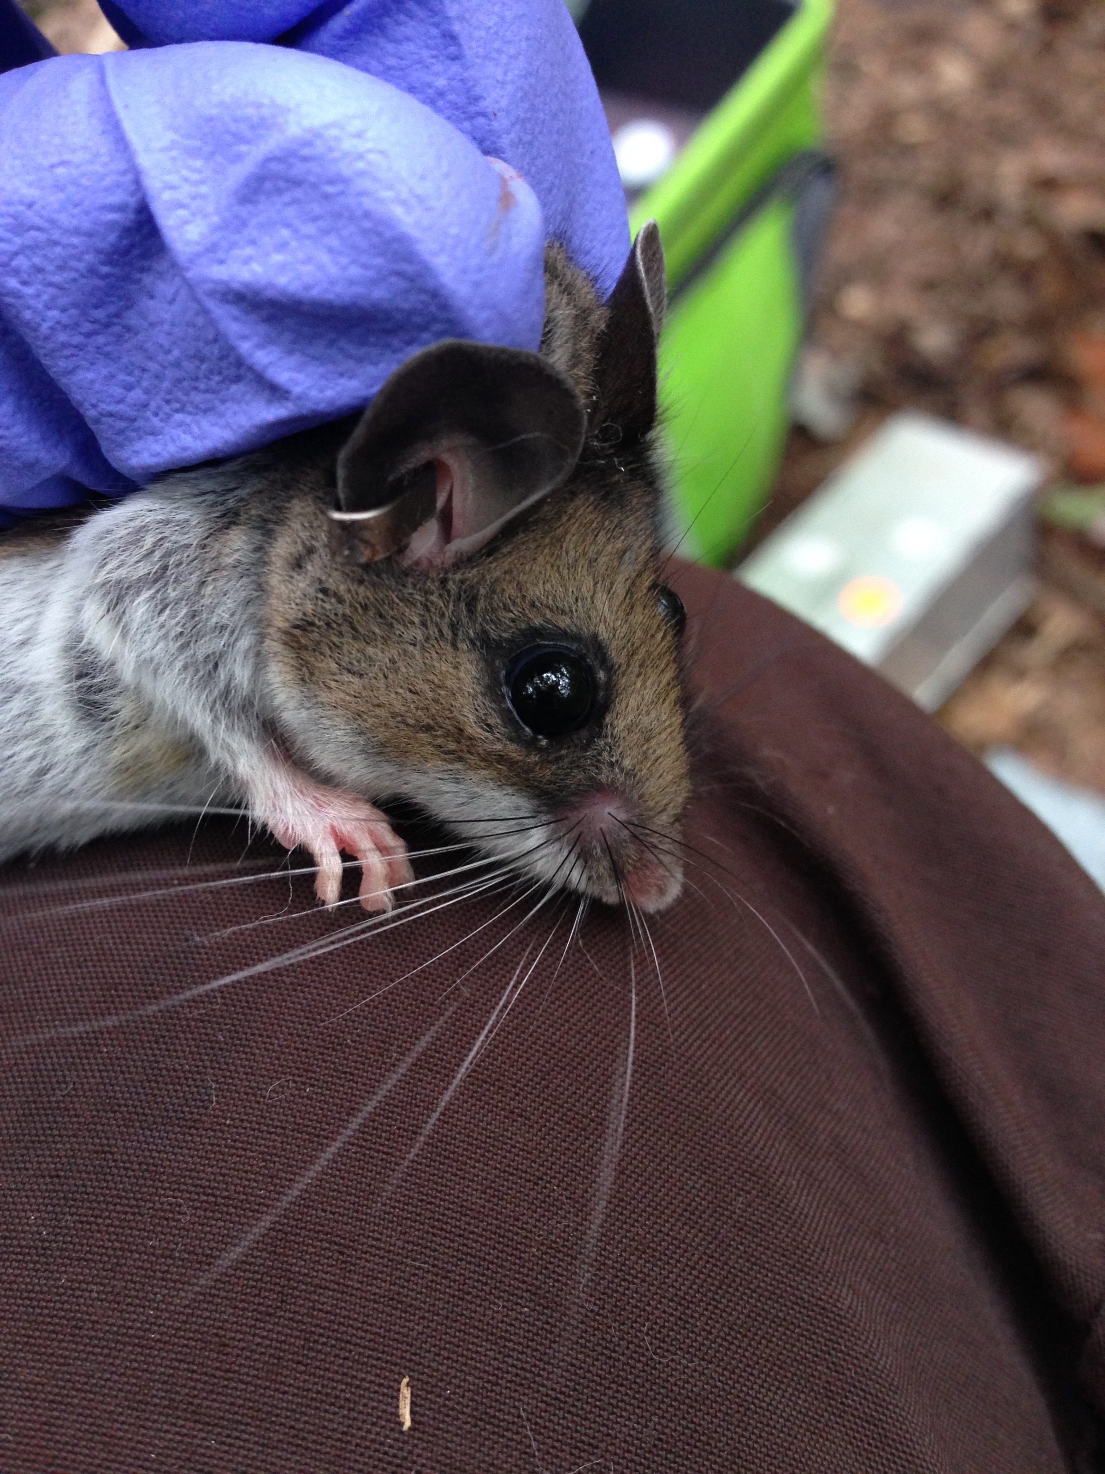
Parasitize the Best of the Best or the Best of the Worst?
How do Intestinal Parasites Choose their Host
in Peromyscus leucopus and P.maniculatus
Deanna Payne

Slide 2
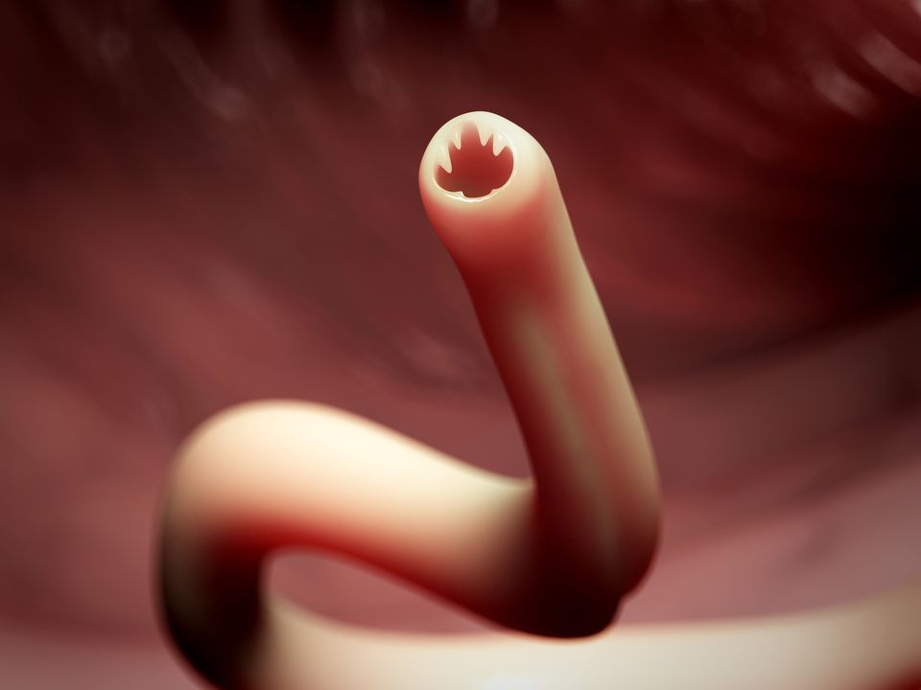
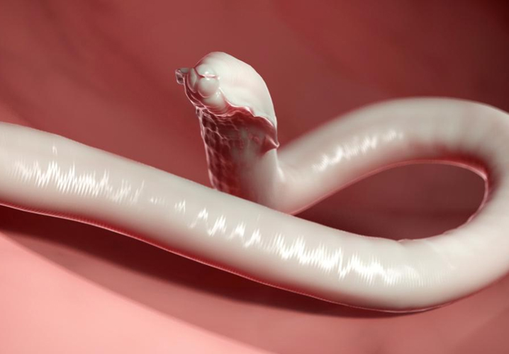
So What?
Intestinal Parasites are important for human health (WHO)…
880 million children need treatment for intestinal parasites worldwide (WHO).
Malnourishment
Impeded Cognitive Development
Compromised Immune System
Anemia
Diarrhea/Dysentery = Dehydration
Hookworm
Roundworm
http://bodyminddetox.com/do-you-have-this-common-intestinal-roundworm/
https://www.thesprucepets.com/hookworms-in-dogs-cats-and-people-3385712
Notes:
Motivation and Background

Slide 3
Princeton U: Graham Lab Mouse Experiment
Notes:
Ecological and evolutionary immunology
Intestinal Parasites and Hanta virus
How does the vertebrate immune system prioritize competing cytokine responses- helminth vs microparasite co-infection
When/How should the immune system multi-task?
Notes:
Approach

Slide 4
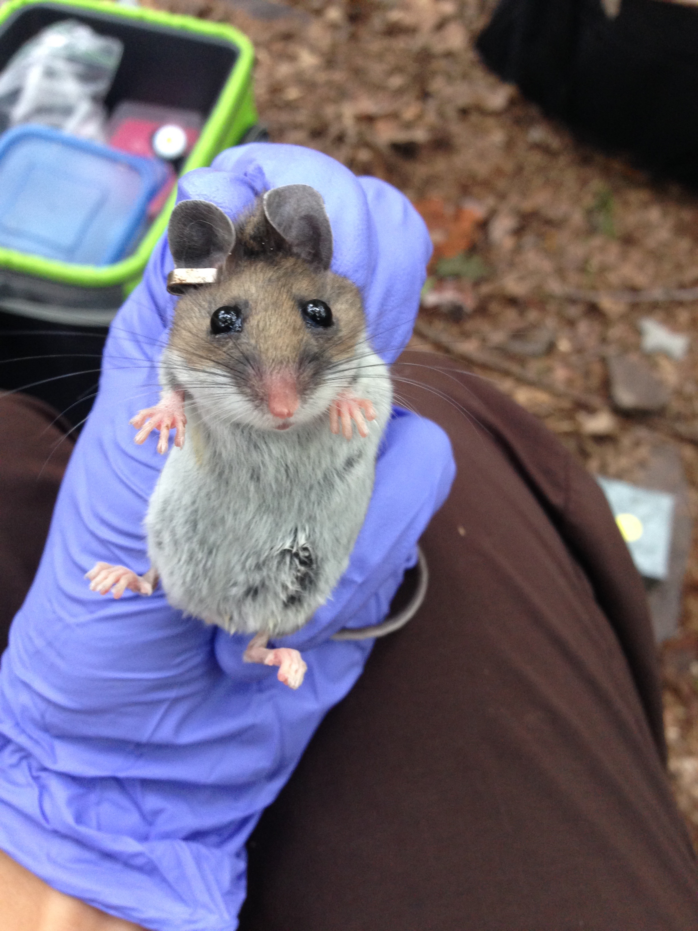
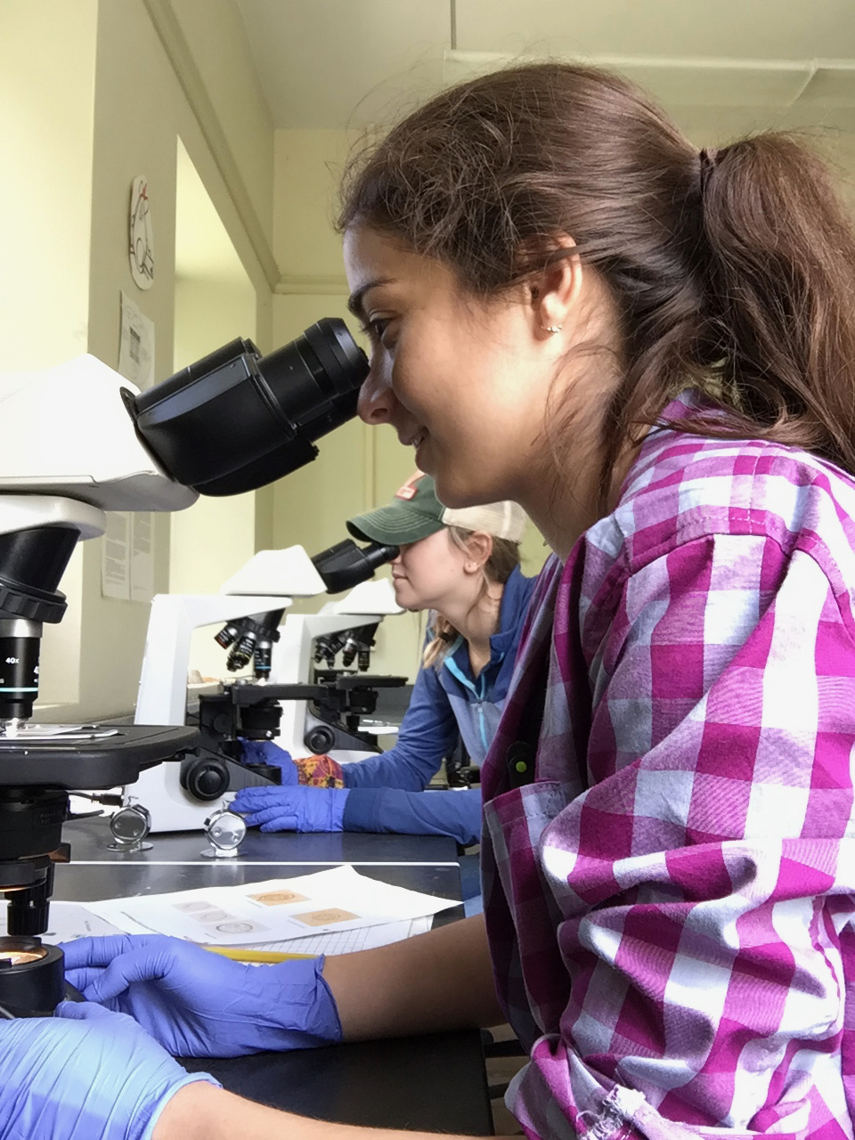

Slide 5
About the Data
Wild tag and recapture
No standard number of data points for any individual mouse
Short life span
High mortality
Migration & Predation
Randomized anti-helminthic treatment and control

Slide 6
Anticipated Details
Define Good Health vs Bad Health
Large body size ≠ Good Health …
Calculate Body Condition
Define parasite load
Parasite diversity
Number of parasites
Track and analyze trends of parasite load over time due to treatment/control/aging
Natural variation vs variation due to experiment

Slide 7
Anticipated Results
Tasty Chick Hypothesis: Poor body condition would impair parasite resistance and render them especially attractive to parasites. (Roulin 2003).
Younger mice will be more attractive to parasites because they are less immunocompetent than their older counterparts.

